Slide 1



“Race
Your
Luck”

Slide 2

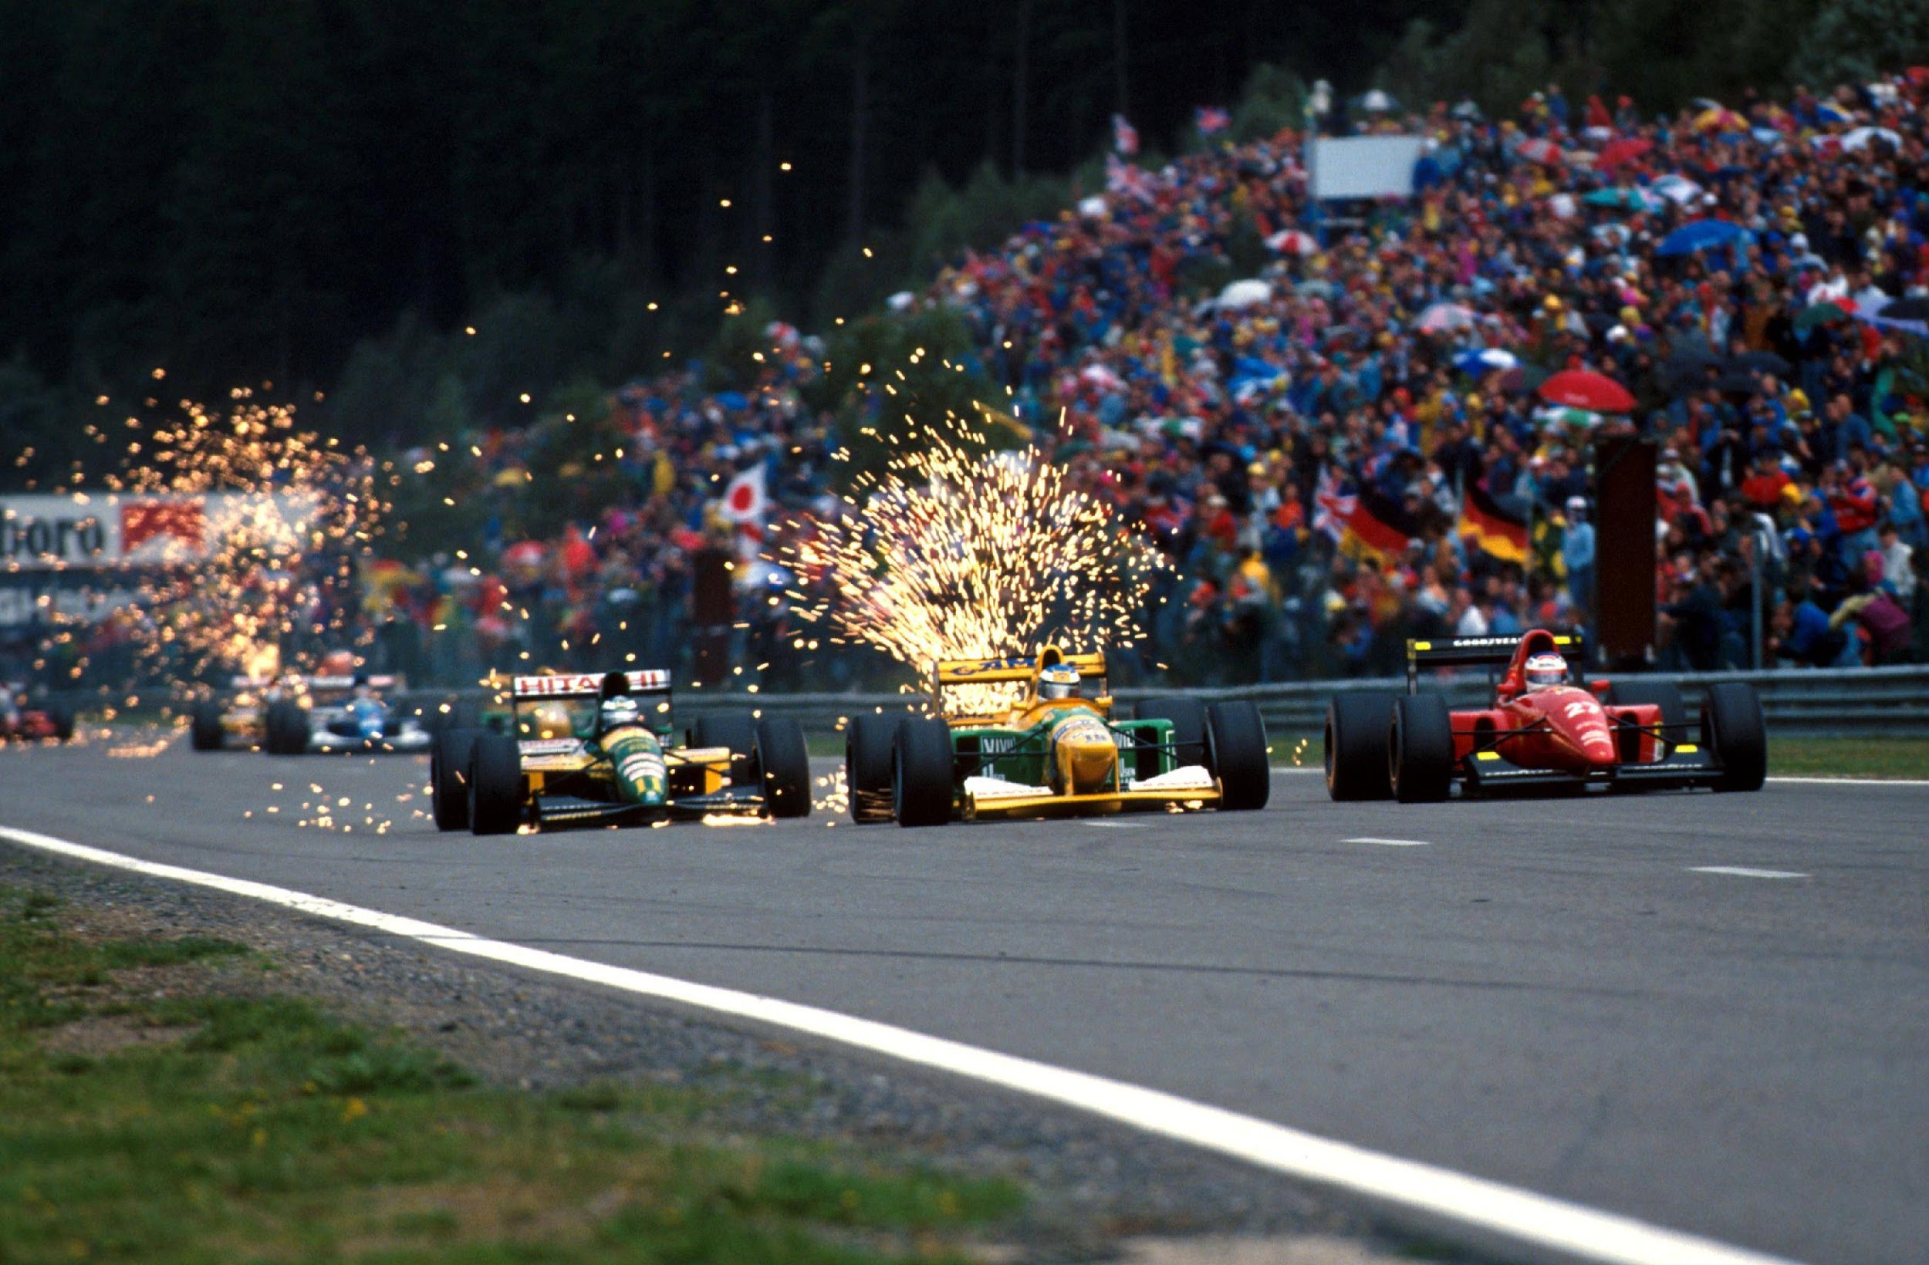




Conducting Races for motorsport enthusiasts on a pay per view basis
COMPANY
HISTORY
Seasonal
Racing
Designing and Manufacturing simple Race Cars
HISTORY + BUSINESS IDEA + MARKETING + FINANCE + COMPANY + EXIT PLAN
Race Car
Manufacturing
Limited Betting Limits with confined Racing Odds
Operating
Betting License

Slide 3


INVESTMENT
$10M
30%
INVESTMENT
EQUITY
HISTORY + BUSINESS IDEA + MARKETING + FINANCE + COMPANY + EXIT PLAN

Slide 4
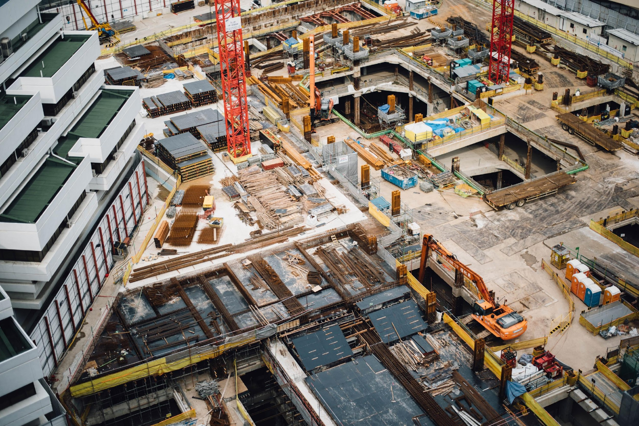
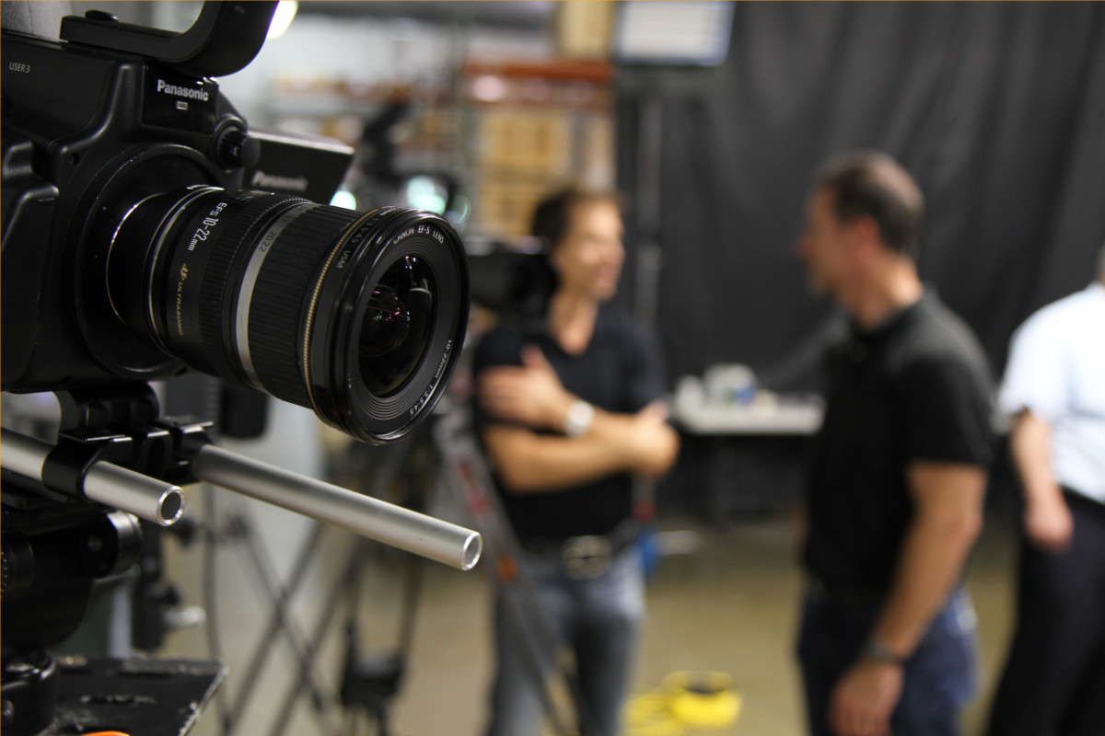

INVESTMENT
BREAKDOWN
Manufacturing
53%
Video Production
17%
30%
HISTORY + BUSINESS IDEA + MARKETING + FINANCE + COMPANY + EXIT PLAN
Facility Setup

Slide 5





COMPETITOR ANALYSIS
NOVELTY
Early Mover’s Advantage
1
Contract with the best Veteran Drivers
2
HISTORY + BUSINESS IDEA + MARKETING + FINANCE + COMPANY + EXIT PLAN
Entertainment
Luxury
Strong backers
3
Returns
Convenience

Slide 6




FAVOURABLE LAWS
Las
Vegas
MARKET
ANALYSIS
Macau
SPORTS BETTING
London
Atlantic
City
Monte
Carlo
AVERAGE GAMBLING BUDGET
HISTORY + BUSINESS IDEA + MARKETING + FINANCE + COMPANY + EXIT PLAN
Las Vegas
$11.8 B
Macau
$9.1 B
GROSS SPORTS GAMING REVENUE
London
$5.5 B
Atlantic City
$2.1 B
Monte Carlo
$1.9 B

Slide 7
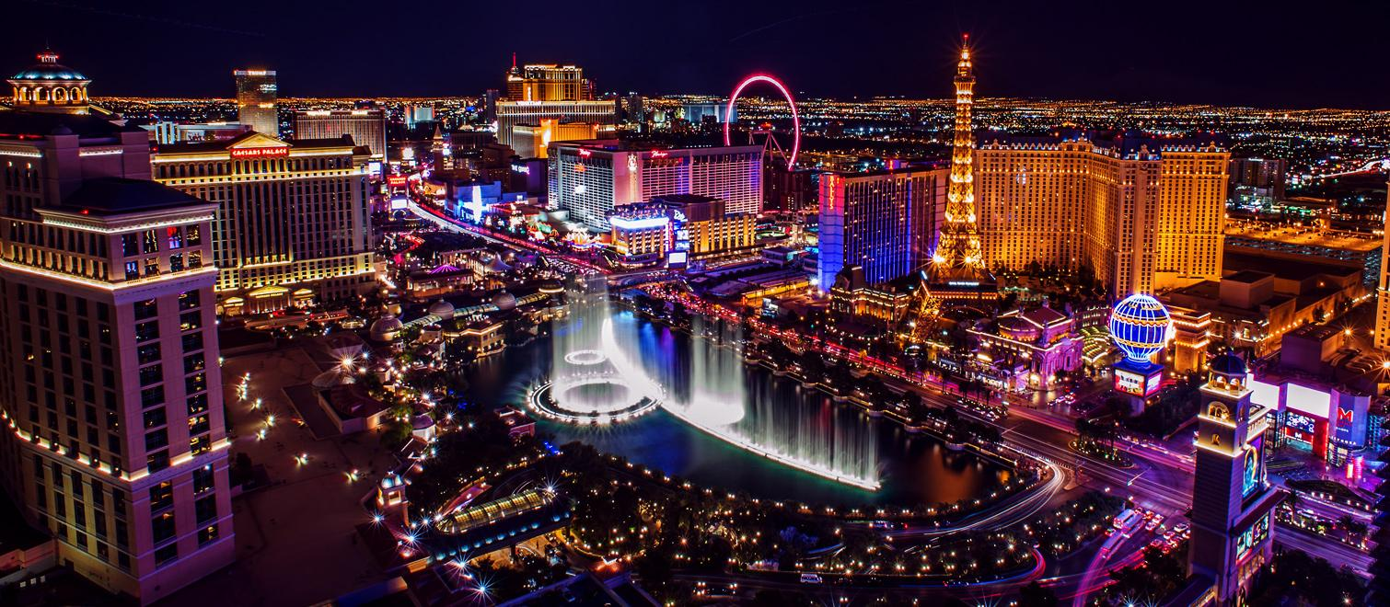





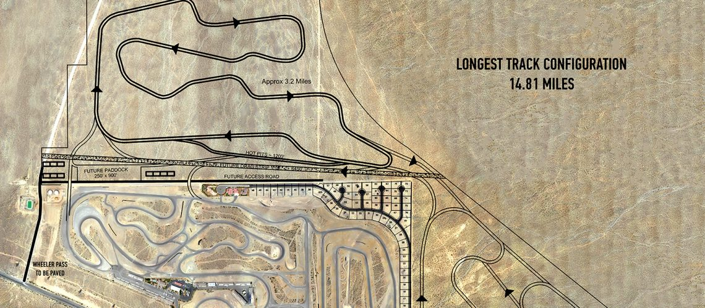



WHY VEGAS
Highest Average Betting Budget
42 Million Visitors annually
HISTORY + BUSINESS IDEA + MARKETING + FINANCE + COMPANY + EXIT PLAN
Longest Modular Race Track in the States
Favorable Gaming Commissions

Slide 8
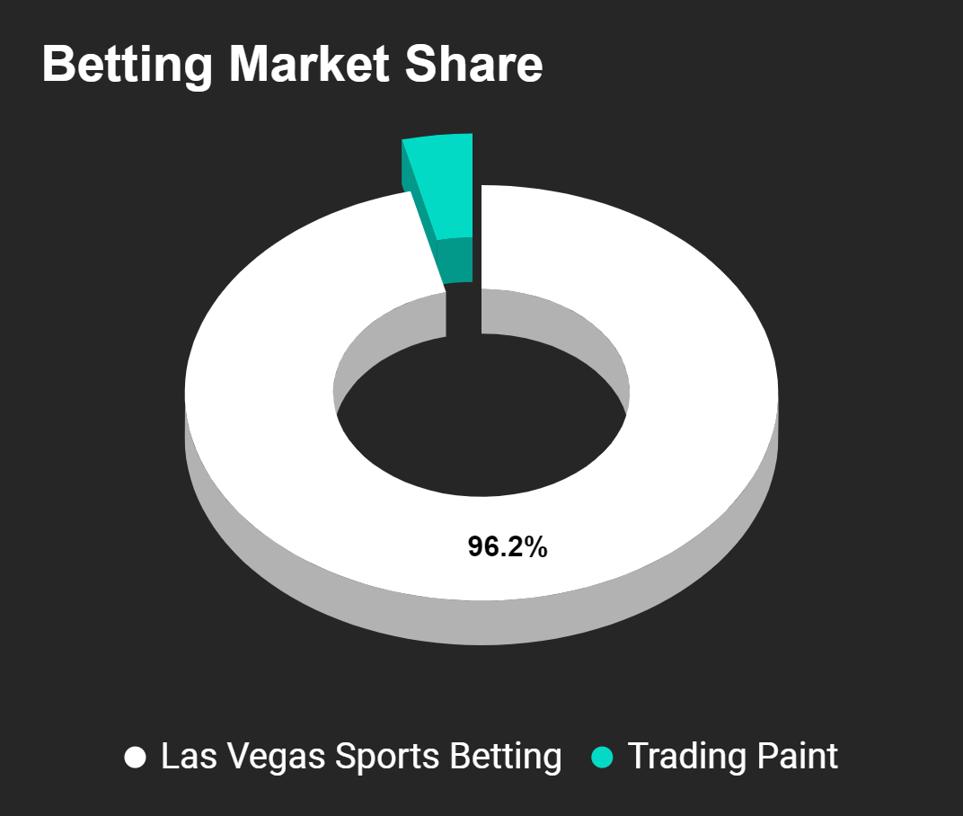
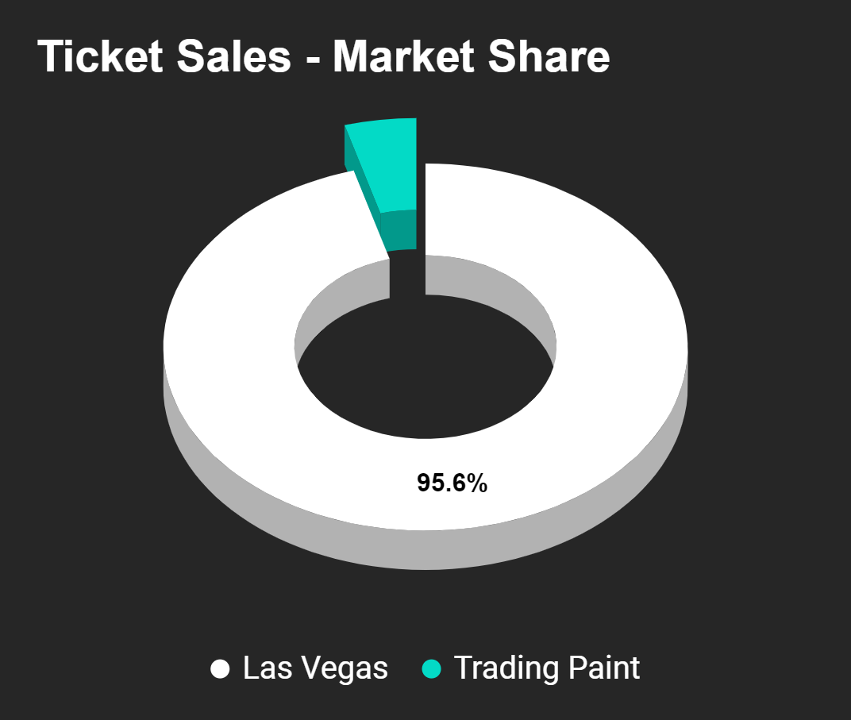
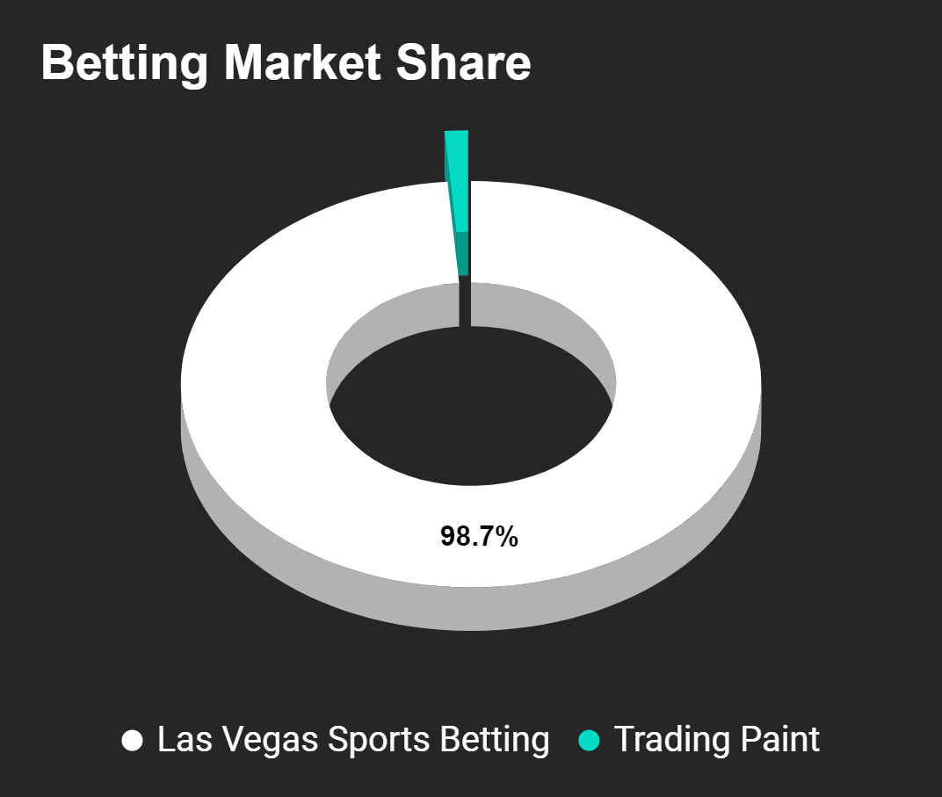
MARKET SHARE (after 5 years)
Betting Market Share
Ticketing Market
Share
HISTORY + BUSINESS IDEA + MARKETING + FINANCE + COMPANY + EXIT PLAN
Las Vegas Sports Betting
Trading Paint
Las Vegas
Events
Trading Paint

Slide 9


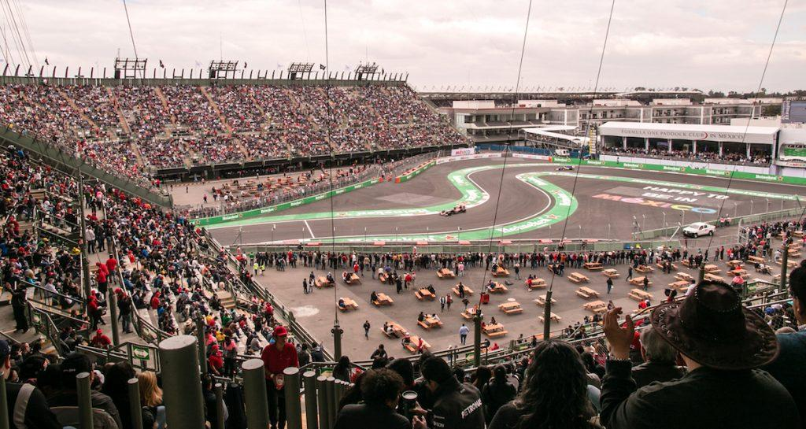
TARGET MARKET
Professional Gamblers
Motorsport Enthusiasts
Tourists & Entertainment Seekers
HISTORY + BUSINESS IDEA + MARKETING + FINANCE + COMPANY + EXIT PLAN

Slide 10
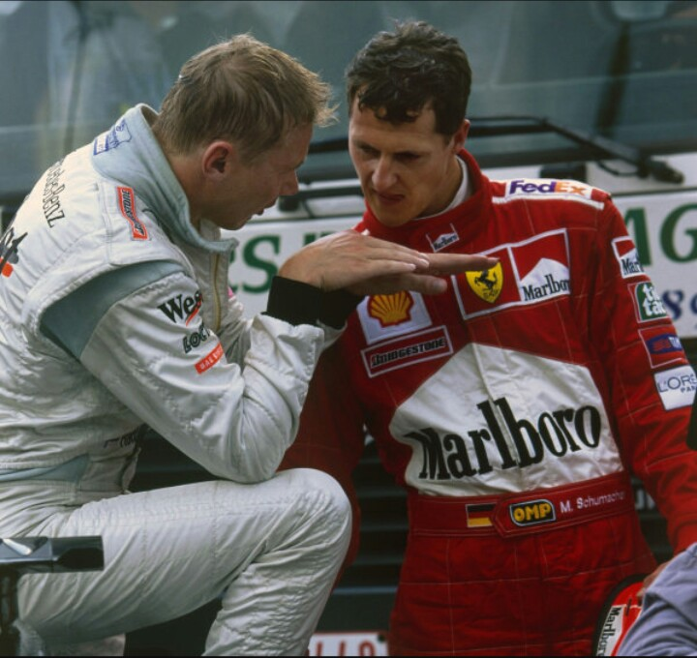

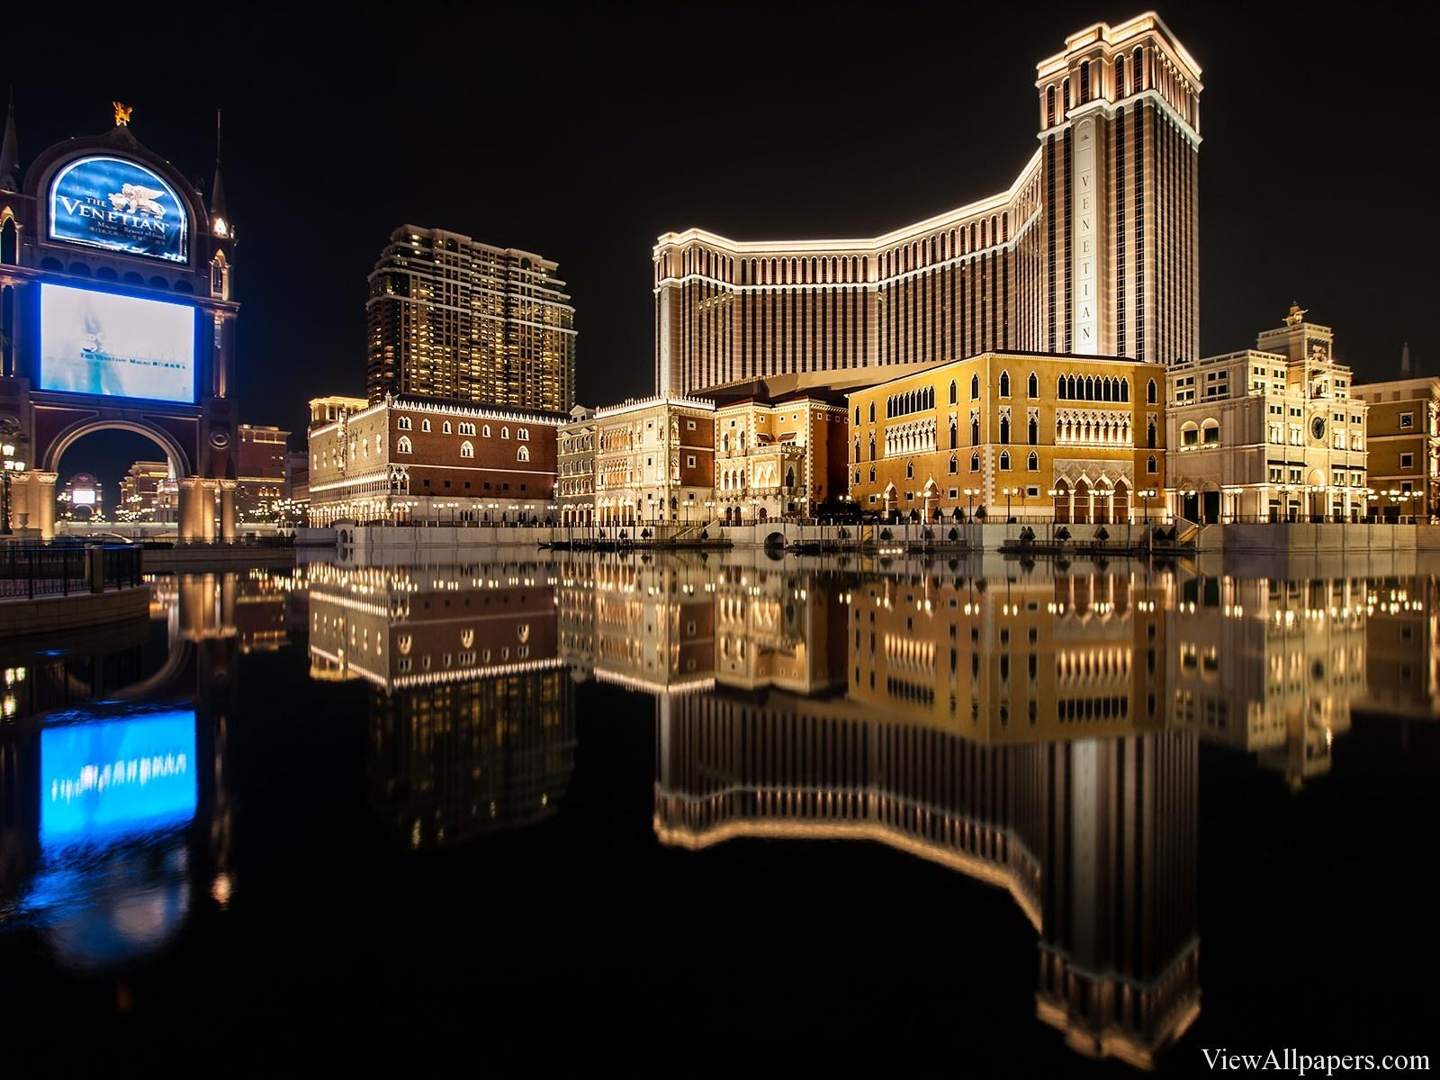


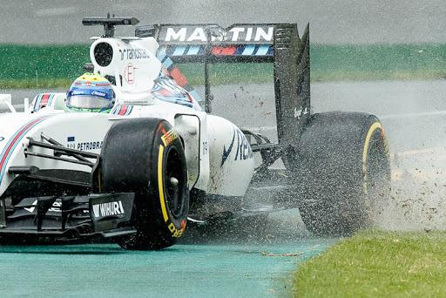

MARKETING
STRATEGY
Veteran Driver Influence
HISTORY + BUSINESS IDEA + MARKETING + FINANCE + COMPANY + EXIT PLAN
Venetian Prominence
Amazon Premier Showcase

Slide 11
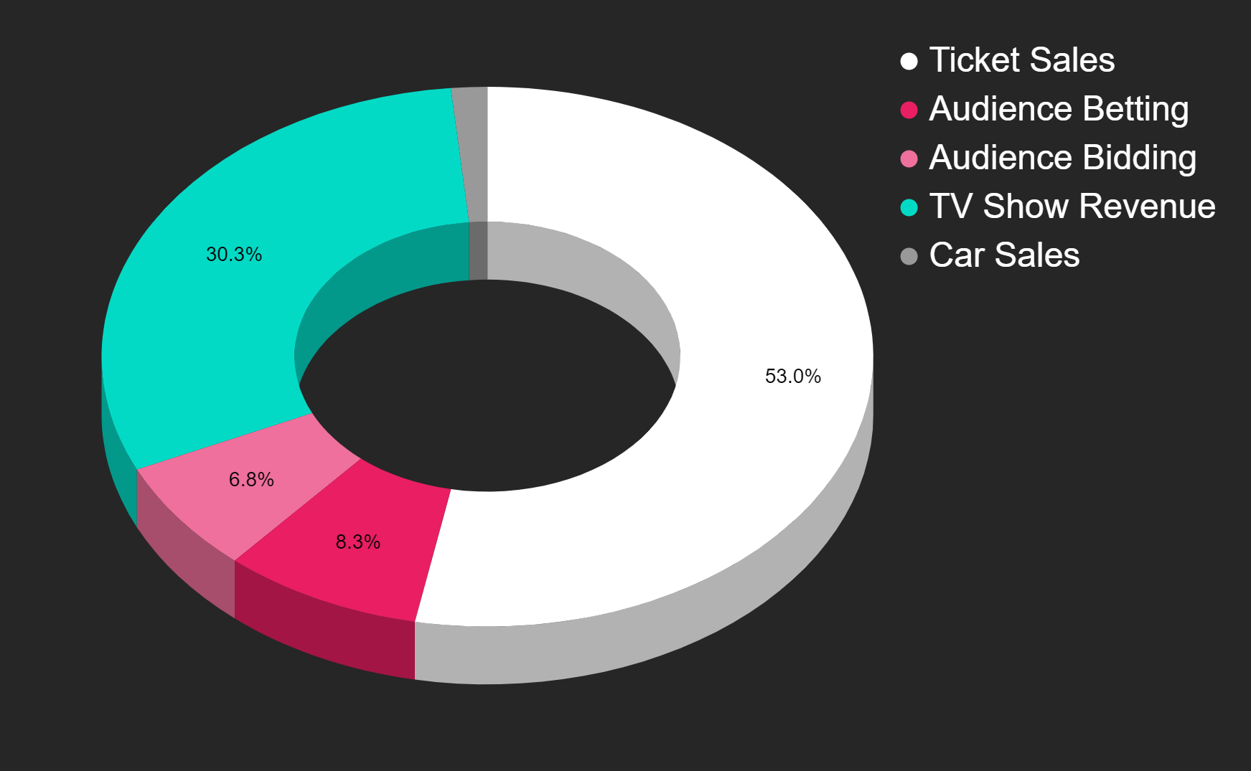

SOURCES OF
REVENUE
1.6%
HISTORY + BUSINESS IDEA + MARKETING + FINANCE + COMPANY + EXIT PLAN

Slide 12
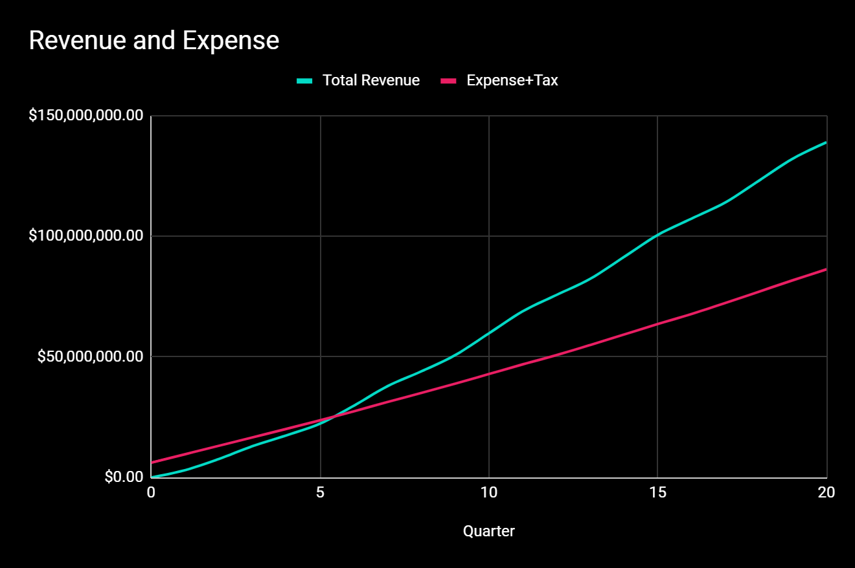
Cumulative
Revenue
Expenses + Tax
Projected Break Even Point
HISTORY + BUSINESS IDEA + MARKETING + FINANCE + COMPANY + EXIT PLAN
Break Even point (6th Quarter)
Quarter

Slide 13
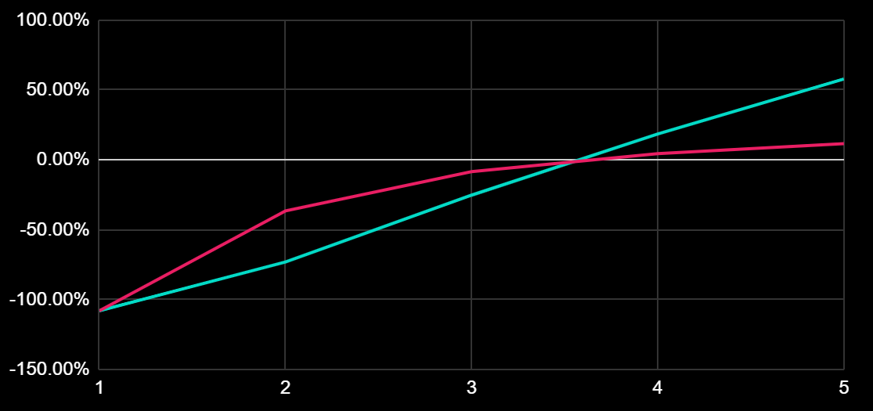
Cumulative ROI
Per Annum ROI
ROI (5 years): 57.8%
Return on Investment
HISTORY + BUSINESS IDEA + MARKETING + FINANCE + COMPANY + EXIT PLAN
Years

Slide 14






Responsible Betting
Prevention of Underage Gambling
Frequency Limits
HISTORY + BUSINESS IDEA + MARKETING + FINANCE + COMPANY + EXIT PLAN
Deposit Limits
Ethical and responsible marketing

Slide 15

Dealing with the Pandemic
Closed-door Races
VR Experience for Audience – Live Bidding + Betting online
HISTORY + BUSINESS IDEA + MARKETING + FINANCE + COMPANY + EXIT PLAN
Team Safety Bubbles

Slide 16



Venture Capitalist
Investors
EXIT PLAN
HISTORY + BUSINESS IDEA + MARKETING + FINANCE + COMPANY + EXIT PLAN
Greater Value Generation
Reduction in Capital Cost
Revenue
Enhancement

Slide 17





SUMMARY
Game
Changing
Product
Marketing
Strategies
Safe
Exit
Plan
Sound
Financial
Planning
Target
Market

Slide 18
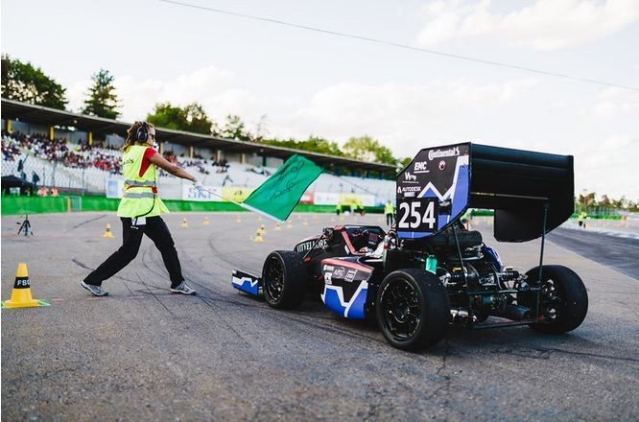
THANK YOU

